Slide 1
Data Analytics
PRESENTED BY ,
ARJUN.M

Slide 2
Data Data is a collection of information Individual facts Statistics Numeric set of values

Slide 3
Data analytics data analytics is the science of analyzing raw data to make conclusion about that information

Slide 4
It’s the basis of data analytics Used for Estimate Prediction
PROBABILITY AND STATISTICS

Slide 5
Probability and statistics It helps to use proper method to collect data , employ the correct analyses and effectively present the result .

Slide 6
advantages of Data analytics Decision making automation prediction

Slide 7
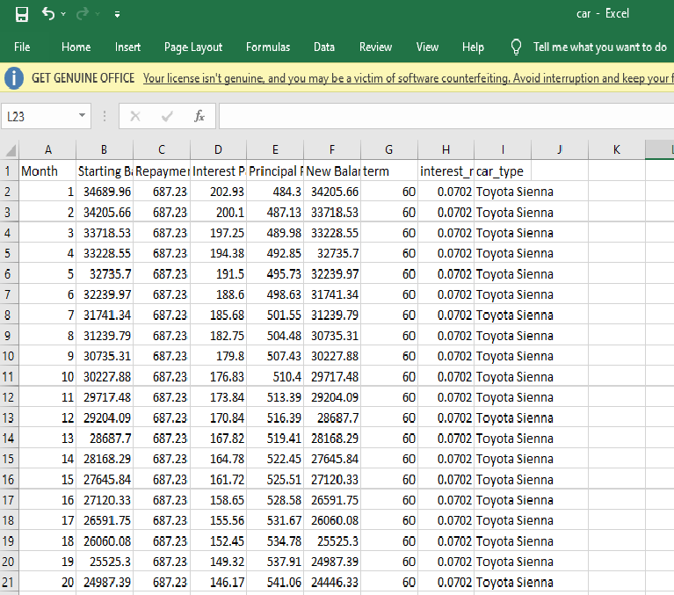
Example

Slide 8
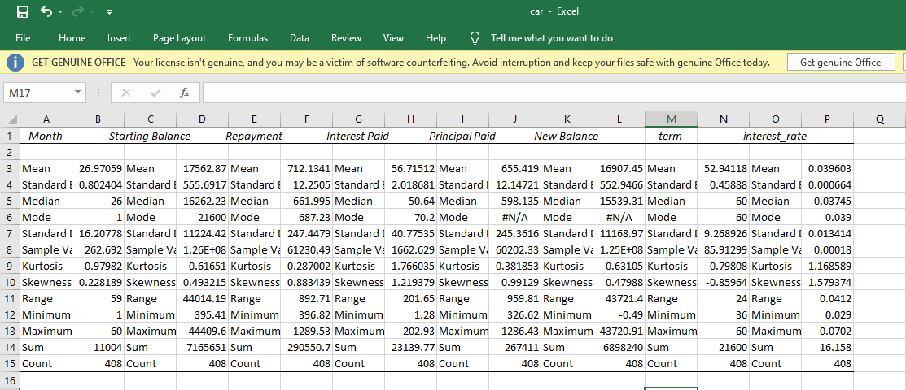
Result

Slide 9
Thank you

